Slide 1
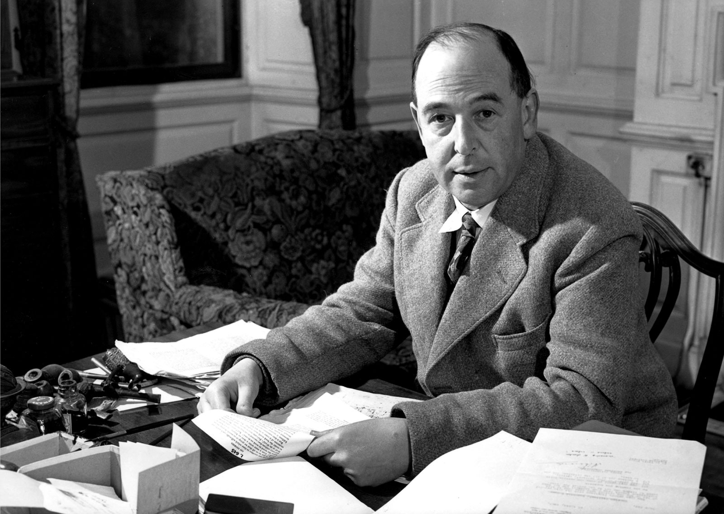
Mere Christianity Facilitator: David W. Brzezinski
Mere Christianity is authored by C.S. Lewis
Image: https://www.britannica.com/biography/C-S-Lewis

Slide 2
Introductions In Class
Facilitator:
Dave Brzezinski
Follower of Jesus made in God’s image continually being sanctified
Married to Erin Brzezinski with two children (Caleb 17 and Faith 14)
Elder and Coordinator Of Discipleship and Adult Education at GBC
Faculty at University of Michigan School of Medicine, AT Still University, Moody Theological Seminary (Christian Ethics)
Training: biomedical sciences (Hope College, University of Michigan Medical School) and theology (Moody Theological Seminary)
Class:
Introductions!
Tell us about yourself.
What is your favorite homemade and/or prepackaged snack?

Slide 3
Favorite Snacks

Slide 4
Mere Christianity – Introduction
Historical Context
1941 in England (WWII)
BBC broadcast of C.S. Lewis’s wartime talks (7:45 to 8:00 p.m.) between a Norwegian news program (in Norwegian) and songs from Welsh cultural festival.
Any “dead air” on the radio would be overtaken by Nazi propaganda on the same wavelength (Lord Haw-Haw) and needed to be filled.
Demand for transcripts eventually led to the publication of Mere Christianity.
Purpose
J.W. Welch of the BBC (director of Religious Broadcasting Department) desired the basics of Christianity to the modern audience.
2/3 of BBC audience lived without any reference to God (and a survey of British army recruits showed only 23% knew the meaning of Easter).
Lewis focused on “general revelation” and humankind’s intuitive concept of morality (right/wrong) to find common ground in discussing the concept of God and religion.

Slide 5
Mere Christianity
Similar Texts (Modern)
Simply Christian – N.T. Wright
The Reason For God – Tim Keller
General Nature Of Text
Rationality / reasonableness of Christian faith proposed and defended.
Loving God with all of our heart, soul, mind, and strength. (Mark 12:28-30)
Major impact on:
Chuck Colson, Christopher Hitchens (atheist), John Lennox (mathematician and Christian apologist from Oxford), etc.
All Christian denominations (which was purposeful on Lewis’s part).

Slide 6
Study It / Think About It
Pause:
Think: Consider agnostics and/or atheists that you know. Consider, too, “skeptics” that you know (family, friends, etc.).
Respond: What is the understanding of your skeptical acquaintances regarding Christianity, and how would you summarize the most important points of Christianity to them?
Major components of Christianity:
_______
_______
_______

Slide 7
Study It / Think About It
Pause:
Think: Disagreement is a normal part of life as well as educated discourse.
Respond: How does C.S. Lewis model disagreement and how have others modeled disagreement well for you?

Slide 8
Mere Christianity: Preface
Where do you stand “denominationally”?
What might be some benefits of having multiple denominations?
What might be some detriments of having multiple denominations?
What does Lewis mean by the term “mere” when he refers to Christianity?
What does the term “Christian” mean to many around the world today? What impact does that have on us as believers and our witness to them?
Who was Richard Baxter?

